Slide 1
STACKS & QUEUES
II
Array Based Approach

Slide 2
Stacks(cont.)
Pop operation should not be applied to the empty stack
Before applying pop operation to the stack ensure that the stack is not empty(us isEmpty() operation prior to pop operation)

Slide 3
Notes on Array Implementation
As we shall see there are several ways to implement stack in C. The most popular solution which is using array is the simplest of these.
The only potential hazard with array implementation is that we need to declare an array size ahead of time.
Although array can not be stack, it can be home of stack.
Array can be declared for the maximum size of the stack. Also another field is needed that, at each point during the operations on stack, keeps track of the current position.

Slide 4
Stack:
#define MAXSTACK 20
struct StackRec
{
int top;
float entry[MAXSTACK];
};
typedef struct StackRec Stack;
top:
entry:
.
.
.

Slide 5
#include”stack.h”
#include<stdio.h>
int main()
{
  Stack s;
  initializeStack(&s);
  push(&s,4.9);
  push(&s,15);
  if(!stackEmpty(&s))
    printf(“\n %f”, pop(&s));
  else
    printf(“\n Stack is empty “);
}

Slide 6
Application
A program that check whether everything is balanced. Thus every } must correspond to { . Brackets and parentheses must correspond to their left counterparts.
The sequence { [ ] } is legal, but { [ } ] is not.
For simplicity just check for balancing of Parentheses, brackets and braches. Ignore any other character appears.

Slide 7
Simple Algorithm uses stack
Make an empty stack, Read characters until end of file(or end of string). If the character is an open anything(“{“,”(“,”[“) push it onto stack. If it s a close anything, then
  If the stack is empty report an error (unbalanced)
  Otherwise, pop the stack. If the symbol popped is not the corresponding opening symbol, then report an error.
At the end of string or file, if the stack is not empty report an error

Slide 8
Example
Assume imput string contains “(()}”
First characters is ( then push character to stack
Read next characters it is again ( then push character to stack
Read next characters it is ) then since stack is not empty pop item from the stack and check if item
(
(

Slide 9
Example
Assume imput string contains “(()}”
First characters is ( then push character to stack
Read next characters it is again ( then push character to stack
Read next characters it is ) then since stack is not empty pop item from the stack and check if item pop and check
(
(
Since corresponding closing symbol is popped
Continue operation without error mesage

Slide 10
Example
Assume imput string contains “(()}”
First characters is ( then push character to stack
Read next characters it is again ( then push character to stack
Read next characters it is ) then since stack is not empty pop item from the stack and check if item
Read next characters, which is }. Since it is close anything
Pop is performed.
(

Slide 11
Example
Assume imput string contains “(()}”
First characters is ( then push character to stack
Read next characters it is again ( then push character to stack
Read next characters it is ) then since stack is not empty pop item from the stack and check if item
Read next characters, which is }. Since it is close anything
Pop is performed.
(
Since ( is not corresponding open symbol for } report
An error and terminate the application.

Slide 12
#include “stack.h”
//macro definitions
#define isOpen(ch) (ch=='{' || ch=='[' || ch=='(')
#define isClose(ch) (ch=='}' || ch==']' || ch==')' )
void readExp(char exprs[])
{
char ch;
int i=0;
printf("\nEnter Expression:");
scanf("%[^\n]s",exprs);
}

Slide 13
int isBalanced(char exp[])
{ int i=0;
char symb;
struct stack s;
createStack(&s);
while(exp[i]!='\0'){
if(isOpen(exp[i]) )
push(&s,exp[i]);
else if(isClose(exp[i]) ){
if(isEmpty(&s) )
return NO;
symb=pop(&s);
switch(symb){
case '{': if(exp[i]!='}')
return NO;
break;
case '[': if(exp[i]!=']')
return NO;
break;
case '(': if(exp[i]!=')')
return NO;
break;
}//end switch
}//end if
i++;
}//end while
if(isEmpty(&s) ) return YES;
return NO;
}//end function

Slide 14
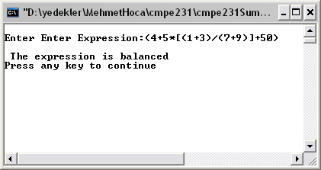
void main()
{
char expr[50];
readExp(expr);
if(isBalanced(expr) )
printf("\n The expression is balanced");
else
printf("\n The expression is not balanced");
}

Slide 15
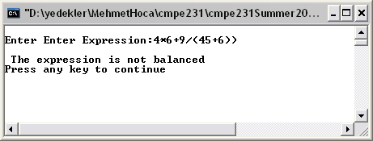

Slide 16
Homework
Write a program to read postfix expression (assume the postfix expression entered is valid) and display fully parenthesized infix version of the expression. (assume only single digit number are allowed)
Ex:
13+4*85/-
The fully parenthesized infix version of the expression above is:
( ( ( 1+3 ) *4 ) - ( 8/5 ) )
the following are the prototypes of functions you should develop;
void readPostfix(char []);
void dispFully(char []);

Slide 17
Hints about homework
typedef struct stack{
int top;
char items[MAX][30];
} STACK ;
/* Pop Implementation */
void pop(STACK *s,char str[])
{
if(isEmpty(s) ){
printf("\n Stack Underflow \n");
exit(1);
}
strcpy(str,s->items[s->top]);
(s->top)--;
}
void push(STACK *s, char str[])
{
if(s->top==MAX-1){
printf("\n Stack Overflow \n");
exit(1);
}
else{
(s->top)++;
strcpy(s->items[s->top],str);
}
}

Slide 18
QUEUE
A queue is simply a waiting line that grows by adding elements to its end and shrinks by removing elements from the front. Compared to stack, it reflects the more commonly used in real-world, namely, “first come, first served”. Waiting lines in supermarkets, banks, food counters are common examples.
A formal definition of queue would be a list from which items may be deleted at one end (front) and into which items may be inserted at the other end (rear). It is also referred to as a first-in-first-out (FIFO) data structure.
Queues are good whenever we have to wait in line
  Queues are “fair”
Queues have many applications in computer systems:
  jobs in a single processor computer
  print spooling
  information packets in computer networks.

Slide 19
The first element inserted into a queue is the first element to be removed.
For this reason queue is called first in first out (FIFO).
delete
Rear
Front
insert

Slide 20
QUEUE
Primitive operations
enqueue(q, x):
inserts item x at the rear of the queue q
x = dequeue(q):
removes the front element from q and returns its value.
isEmpty(q) : Check to see if the queue is empty.
isFull(q) : checks to see if there is space to insert more items in the queue.

Slide 21
Enqueue Operation
Insert 8
8
Rear
Front

Slide 22
Enqueue Operation
Insert 10
Insert 8
Insert 860
Insert -60
10
860
-60
Rear
Front
8

Slide 23
Enqueue Operation
Insert 10
Insert 8
Insert 860
Insert -60
10
-60
Rear
Front
860
8

Slide 24
Enqueue Operation
Insert 10
Insert 8
Insert 860
Insert -60
10
Rear
Front
-60
860
8

Slide 25
Enqueue Operation
Insert 10
Insert 8
Insert 860
Insert -60
Rear
Front
10
-60
860
8

Slide 26
Insert 10
Insert 8
Insert 860
Insert -60
Rear
Front
10
-60
860
8
Dequeue Operation

Slide 27
Insert 10
Insert 8
Insert 860
Insert -60
Rear
Front
10
-60
860
8
Dequeue Operation

Slide 28
Insert 10
Insert 8
Insert 860
Insert -60
Rear
Front
10
-60
8
860
Dequeue Operation

Slide 29
Insert 10
Insert 8
Insert 860
Insert -60
Rear
Front
10
8
860
-60
Dequeue Operation

Slide 30
Insert 10
Insert 8
Insert 860
Insert -60
Rear
Front
860
-60
10
8
Dequeue Operation

Slide 31
Example
Consider the following sequence of operations being performed ona queue “q”which stores integers:
enqueue(q, 9);
enqueue(q, 10);
enqueue(q, 50);
x = dequeue(q);
Print(x)
enqueue(q, 20);
enqueue(q, -40);
x = dequeue(q);
Print(x)
enqueue(q, 40);
x = dequeue(q);
Print(x)
enqueue(q, 30);

Slide 32
Example
Consider the following sequence of operations being performed ona queue “q”which stores integers:
enqueue(q, 9);
enqueue(q, 10);
enqueue(q, 50);
x = dequeue(q);
Print(x)
enqueue(q, 20);
enqueue(q, -40);
x = dequeue(q);
Print(x)
enqueue(q, 40);
x = dequeue(q);
Print(x)
enqueue(q, 30);

Slide 33
Example
Consider the following sequence of operations being performed ona queue “q”which stores integers:
enqueue(q, 9);
enqueue(q, 10);
enqueue(q, 50);
x = dequeue(q);
Print(x)
enqueue(q, 20);
enqueue(q, -40);
x = dequeue(q);
Print(x)
enqueue(q, 40);
x = dequeue(q);
Print(x)
enqueue(q, 30);
9
Front
Rear

Slide 34
Example
Consider the following sequence of operations being performed ona queue “q”which stores integers:
enqueue(q, 9);
enqueue(q, 10);
enqueue(q, 50);
x = dequeue(q);
Print(x)
enqueue(q, 20);
enqueue(q, -40);
x = dequeue(q);
Print(x)
enqueue(q, 40);
x = dequeue(q);
Print(x)
enqueue(q, 30);
9
10
Front
Rear

Slide 35
Example
Consider the following sequence of operations being performed ona queue “q”which stores integers:
enqueue(q, 9);
enqueue(q, 10);
enqueue(q, 50);
x = dequeue(q);
Print(x)
enqueue(q, 20);
enqueue(q, -40);
x = dequeue(q);
Print(x)
enqueue(q, 40);
x = dequeue(q);
Print(x)
enqueue(q, 30);
9
10
50
Front
Rear

Slide 36
Example
Consider the following sequence of operations being performed ona queue “q”which stores integers:
enqueue(q, 9);
enqueue(q, 10);
enqueue(q, 50);
x = dequeue(q);
Print(x)
enqueue(q, 20);
enqueue(q, -40);
x = dequeue(q);
Print(x)
enqueue(q, 40);
x = dequeue(q);
Print(x)
enqueue(q, 30);
10
50
9
Front
Rear
Output

Slide 37
Example
Consider the following sequence of operations being performed ona queue “q”which stores integers:
enqueue(q, 9);
enqueue(q, 10);
enqueue(q, 50);
x = dequeue(q);
Print(x)
enqueue(q, 20);
enqueue(q, -40);
x = dequeue(q);
Print(x)
enqueue(q, 40);
x = dequeue(q);
Print(x)
enqueue(q, 30);
10
50
20
Front
Rear
Output
9

Slide 38
Example
Consider the following sequence of operations being performed ona queue “q”which stores integers:
enqueue(q, 9);
enqueue(q, 10);
enqueue(q, 50);
x = dequeue(q);
Print(x)
enqueue(q, 20);
enqueue(q, -40);
x = dequeue(q);
Print(x)
enqueue(q, 40);
x = dequeue(q);
Print(x)
enqueue(q, 30);
10
50
20
-40
Front
Rear
Output
9

Slide 39
Example
Consider the following sequence of operations being performed ona queue “q”which stores integers:
enqueue(q, 9);
enqueue(q, 10);
enqueue(q, 50);
x = dequeue(q);
Print(x)
enqueue(q, 20);
enqueue(q, -40);
x = dequeue(q);
Print(x)
enqueue(q, 40);
x = dequeue(q);
Print(x)
enqueue(q, 30);
50
20
-40
10
Front
Rear
Output
9

Slide 40
Example
Consider the following sequence of operations being performed ona queue “q”which stores integers:
enqueue(q, 9);
enqueue(q, 10);
enqueue(q, 50);
x = dequeue(q);
Print(x)
enqueue(q, 20);
enqueue(q, -40);
x = dequeue(q);
Print(x)
enqueue(q, 40);
x = dequeue(q);
Print(x)
enqueue(q, 30);
50
20
-40
40
Front
Rear
Output
9
10

Slide 41
Example
Consider the following sequence of operations being performed ona queue “q”which stores integers:
enqueue(q, 9);
enqueue(q, 10);
enqueue(q, 50);
x = dequeue(q);
Print(x)
enqueue(q, 20);
enqueue(q, -40);
x = dequeue(q);
Print(x)
enqueue(q, 40);
x = dequeue(q);
Print(x)
enqueue(q, 30);
20
-40
40
50
Front
Rear
Output
9
10

Slide 42
Example
Consider the following sequence of operations being performed ona queue “q”which stores integers:
enqueue(q, 9);
enqueue(q, 10);
enqueue(q, 50);
x = dequeue(q);
Print(x)
enqueue(q, 20);
enqueue(q, -40);
x = dequeue(q);
Print(x)
enqueue(q, 40);
x = dequeue(q);
Print(x)
enqueue(q, 30);
20
-40
40
30
Front
Rear
Output
9
10
50

Slide 43
Array Implementation of Queues
Array Implementation of Queues
The array to implement the queue would need two variables (indices) called front and rear to point to the first and the last elements of the queue.
Initially:
  q->rear = -1;
  q->front = 0;
For each enqueue operation rear is incremented by one, and for each dequeue operation , front is incremented by one.
While the enqueue and dequeue operations are easy to implement, there is a big disadvantage in this set up. The size of the array needs to be huge, as the number of slots would go on increasing as long as there are items to be added to the list (irrespective of how many items are deleted, as these two are independent operations.)
0
1
2
3
4
5
6
7
8
9
10
11
12
13
14
15
10
50
13
5
-8
14
Front
Rear

Slide 44
#ifndef QUEUEH
#define QUEUEH
#include <stdbool.h>
#define MAXQUEUE 20
#define BOOL int
#define TRUE 1
#define FALSE 0
struct QueueRec
{
int front;
int rear;
float entry[MAXQUEUE];
};
typedef struct QueueRec Queue;
void intializeQueue(Queue* queuePtr);
BOOL queueEmpty(const Queue* queuePtr);
BOOL queueFull(const Queue* queuePtr);
void enqueue(Queue* queuePtr, float item);
float dequeue(Queue* queuePtr);
#endif

Slide 45
Queue:
#define MAXQUEUE 20
struct QueueRec
{
int count;
int front;
int rear;
float entry[MAXQUEUE];
};
typedef struct QueueRec Queue;
front:
rear:
entry:
.
.
.

Slide 46
Implementation
Initially q.rear is set to -1, and q.front is set to 0. The queue is empty whenever q.rear<q.front. The number of elements in the queue at any time is equal to the value of q.rear-q.front+1
Insert operation involves testing for overflow, which occurs when the entire array is occupied by items of the queue and attempt to made to insert yet another element into the queue.

Slide 47
#include <stdio.h>
#include <stdlib.h>
#include “queue.h”
void initializeQueue(Queue* queuePtr)
{
queuePtr -> front = 0;
queuePtr -> rear = -1;
}
Queue:
front:
0
queuePtr:
addr of Queue
rear:
-1
entry:
.
.
.
47

Slide 48
BOOL queueEmpty(const Queue* queuePtr)
{
if (queuePtr->rear < queuePtr->front)
{
return TRUE;
}
else
{
return FALSE;
}
}
48

Slide 49
BOOL queueFull(Queue* queuePtr)
{
if (queuePtr->rear==MAXSIZE)
{
return TRUE;
}
else
{
return FALSE;
}
}
49

Slide 50
void enqueue(Queue* queuePtr, float item)
{
if (queueFull(queuePtr))
{
fprintf(stderr, “Queue is full\n”);
exit(1);
}
else
{
queuePtr->rear++;
queuePtr->entry[queuePtr->rear] = item;
}
}
50

Slide 51
float dequeue(Queue* queuePtr)
{
float item;
if (queueEmpty(queuePtr)) {
fprintf(stderr, “Queue is empty\n”);
exit(1);
}
else {
item = queuePtr->entry[queuePtr->front];
queuePtr->front++;
}
return item;
}
51

Slide 52
Linear Implementation
0
1
2
3
4
5
6
7
Front
Rear

Slide 53
Enqueue
0
1
2
3
4
5
6
7
Front
Rear

Slide 54
Enqueue
0
1
2
3
4
5
6
7
Front
Rear

Slide 55
Deque
0
1
2
3
4
5
6
7
Front
Rear
This comes off the queue

Slide 56
Deque
0
1
2
3
4
5
6
7
Front
Rear
This comes off the queue

Slide 57
Deque
0
1
2
3
4
5
6
7
Front
Rear

Slide 58
Enqueue
0
1
2
3
4
5
6
7
Front
Rear
NO ROOM
HERE

Slide 59
Enqueue
0
1
2
3
4
5
6
7
Front
Rear
ROOM HERE

Slide 60
Discussion
It is possible to reach the absurd situation where the queue is empty, yet no new element can be inserted.
Solution is to view the array that holds the queue as a circle rather than straight line.
That is imagine the first element of the array(postion 0) as immediately following the last element.
This implies that even if the last element is occupied, a new value can be inserted behind it in the first element of the array as long as the first element is empty

Slide 61
Circular Implementation
0 1 2 3 4 5 6 7
7
0
6
1
5
2
4
3

Slide 62
Example
Consider the following example and assume queue size is 5
E
q.rear=4
Although the array is not full its last element is occupied
D
C
q.front=2

Slide 63
Example(cont.)
If item F is now inserted into queue it can be placed in position 0 of the array
E
D
C
q.front=2
F
q.rear=0

Slide 64
Unfortunately it is difficult under current representation to determine when the queue is empty. The condition
q.rear<q.front is no longer valid as a test for the empty queue

Slide 65
One way of solving this problem is to establish the convention that the value of q.front is preceding the first element of the queue rather than the index of the first element.
Thus q.rear is the index of the last element of the queue, the condition q.front==q.rear implies that the queue is empty

Slide 66
Excercises
Transform each of following expressions to postfix
(A+B)*(C-D)^E*F
(A+B)*(C^(D-E)+F)-G
A+(((B-C)*(D-E)+F)/G)^(H-J)
Transform each of the following postfix expression into infix
AB+C-
ABC+-
AB-C+DEF-+^
ABCDE-+^EF*-

Slide 67
Implement stack in C in which each item on the stack is pair of integers( i.e. x and y coordinates of otto robot).
Design a method for keeping two stacks within a single linear array so that neither stack overflows until all of memory is used and an entire stack is never shifted to different locations within the array. Write C routines puhs1 push2 pop1 pop2 to manipulate stacks

Slide 68
Queues
Circular Implementation of Queues

Slide 69
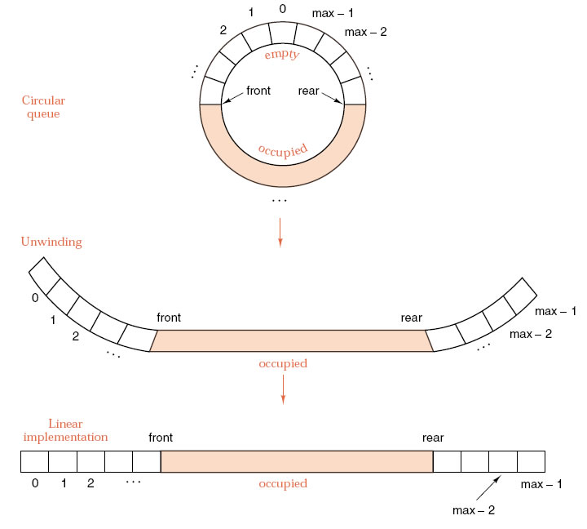

Slide 70
Circular arrays in C
Equivalent methods to increment an index i in a circular array:
i = ((i C 1) == max) ? 0 : (i C 1);
if ((i C 1) == max) i = 0; else i = i C 1;
i = (i C 1)%max;

Slide 71
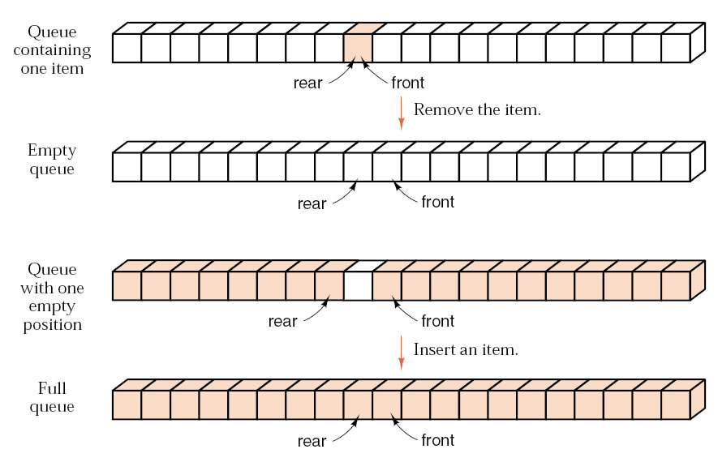
Boundary Conditions

Slide 72
Implementations of Queues
The physical model: a linear array with the front always in the first position and all entries moved up the array whenever the front is deleted.
A linear array with two indices always increasing.
A circular array with front and rear indices and one position left vacant.
A circular array with front and rear indices and a Boolean flag to indicate fullness (or emptiness).
A circular array with front and rear indices and an integer counter of entries.
A circular array with front and rear indices taking special values to indicate emptiness.

Slide 73
Remember
For each enqueue operation rear is incremented by one, and for each dequeue operation , front is incremented by one.
While the enqueue and dequeue operations are easy to implement, there is a big disadvantage in this set up. The size of the array needs to be huge, as the number of slots would go on increasing as long as there are items to be added to the list (irrespective of how many items are deleted, as these two are independent operations.)

Slide 74
Example
To illustrate the use of circular array, let us take an example of a Queue with 7 slots, i.e. size is 7. The indices front and rear can take on values from 0 to (size –1) corresponding to elements present in the queue.
Initially there are no elements, so let us keep both front and rear equal to –1 (rear=front= –1 )
Now let us study the effect of following operations and see how front and rear indices are changed.
Enqueue 20
Since rear = -1, element 20 will be stored in slot 0.
20
front
rear
-1
Front
0
Rear
Since circular array is used the condition rear<fron is no longer valid as a test for empty queue.

Slide 75
Example cont.
Enqueue 15
Note this operation does not affect the index front, which remains at 0. There are two elements in the queue, so the last element added moves value of index rear to 1.
20
15
front
rear
-1
Front
1
Rear

Slide 76
Enqueue 6
Enqueue 11
Check if there is still space in the queue. If rear is not yet equal to size –1 , slots are still available in the queue. So increment rear and put the new element there. This will take rear to 3.
20
15
6
11
front
rear
-1
Front
3
Rear

Slide 77
At this point we ask the Queue to remove an element.
x =Dequeue
It is going to remove the element being pointed by front when incremented,(before performing delete don’t forget to check emptyness of queue) which is 20. This means the element at front is now 15 located at position 1.
15
6
11
front
rear
0
Front
3
Rear

Slide 78
Now we perform
Enqueue 9
Enqueue 7
15
6
11
9
7
front
rear
0
Front
5
Rear

Slide 79
x =Dequeue
x =Dequeue
This will cause 15 and 6 be removed from the queue, and the index front to move to 2, as 11 is the element currently in front.
11
9
7
front
rear
2
Front
5
Rear

Slide 80
Enqueue 4
What will happen now? There are no slots after 7, but part of the queue is still empty. So the new element can be put in the first position, which gives us the rule
if rear = size –1 then put the element in slot 0 and assign rear = 0.”
4
11
9
7
rear
front
2
Front
0
Rear

Slide 81
Enqueue 6
The picture at this stage looks like this
Value of front precedes the first element of the queue rather than the index of the first element itself. Thus the condition front==rear implies that queue is empty and
front==rear+1 implies queue is full
What is the disadvantage of this approach?
Further insertions should be rejected since queue is full
4
6
11
9
7
rear
front
2
Front
1
Rear

