Slide 1
Priority Queues (Heaps)

Slide 2
Queues are a standard mechanism for ordering tasks on a first-come, first-served basis
However, some tasks may be more important or timely than others (higher priority)
Priority queues
Store tasks using a partial ordering based on priority
Ensure highest priority task at head of queue
Heaps are the underlying data structure of priority queues

Slide 3
Priority Queues: Specification
Main operations
insert (i.e., enqueue)
Dynamic insert
specification of a priority level (0-high, 1,2.. Low)
deleteMin (i.e., dequeue)
Finds the current minimum element (read: “highest priority”) in the queue, deletes it from the queue, and returns it
Performance goal is for operations to be “fast”

Slide 4
Using priority queues
4
10
19
5
3
13
8
11
22
insert()
deleteMin()
Dequeues the next element with the highest priority
2

Slide 5
Simple Implementations
Unordered linked list
O(1) insert
O(n) deleteMin
Ordered linked list
O(n) insert
O(1) deleteMin
Ordered array
O(lg n + n) insert
O(n) deleteMin
Balanced BST
O(log₂n) insert and deleteMin
2
10
…
3
5
3
5
…
10
2
2 | 3 | 5 | … | 10

Slide 6
Binary Heap
A Heap is a Binary Tree H that stores a collection of
keys at its internal nodes and that satisfies two
additional properties:
-1)Relational Property
-2)Structural Property

Slide 7
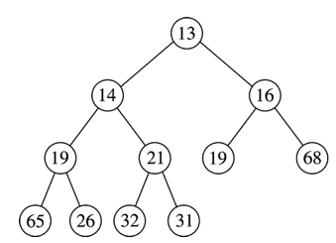
Heap-order Property(Relational Property)
Heap-order property (for a “MinHeap”)
For every node X, key(parent(X)) ≤ key(X)
Except root node, which has no parent
Thus, minimum key always at root
Alternatively, for a “MaxHeap”, always keep the maximum key at the root
Insert and deleteMin must maintain heap-order property
Minimum element

Slide 8
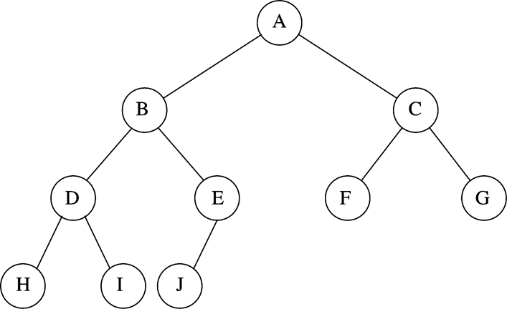
Structure Property
A binary heap is a complete binary tree
Each level (except possibly the bottom most level) is completely filled
The bottom most level may be partially filled (from left to right)
Height of a complete binary tree with N elements is
N=10
Height = 3
Every level (except last) saturated

Slide 9
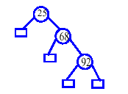
A structure which fails to fulfill the Structural Property

Slide 10
A binary tree satisfies the (min-)heap-order property if every child greater than (or equal to) parent (if exist).
A binary min-heap is a left-complete binary tree that also satisfies the heap-order property.
13
Note that there is no definite order between values in sibling nodes; also, it is obvious that the minimum value is at the root.
21
16
24
31
19
68
65
26
32
A binary min-heap

Slide 11
Binary Heaps: Array Implementation
06
0
Implementing binary heaps.
Use an array: no need for explicit parent or child pointers(or index values).
Parent(i) = ⎣i/2⎦
Left(i) = 2i+ 1
Right(i) = 2i + 2
14
45
1
2
78
18
47
53
3
4
5
6
83
91
81
77
84
99
64
7
8
9
10
11
12
13
index
0 | 1 | 2 | 3 | 4 | 5 | 6 | 7 | 8 | 9 | 11 | 12 | 13 | 14
06 | 14 | 45 | 78 | 18 | 47 | 53 | 83 | 91 | 81 | 77 | 84 | 99 | 64
Array

Slide 12
Binary Heap: Insertion
Insert element x into heap.
Insert into next available slot.
Bubble up until it's heap ordered.
06
14
45
78
18
47
53
83
91
81
77
84
99
64
42
next free slot

Slide 13
Binary Heap: Insertion
swap with parent
06
14
45
78
18
47
53
83
91
81
77
84
99
64
42
42

Slide 14
Binary Heap: Insertion
swap with parent
06
14
45
78
18
47
42
83
91
81
77
84
99
64
42
53

Slide 15
Binary Heap: Insertion
O(log N) operations
stop: heap ordered
06
14
42
78
18
47
45
83
91
81
77
84
99
64
53

Slide 16
Binary Heap: Decrease Key
Decrease key of element x to k.
Bubble up until it's heap ordered.
O(log N) operations.
Ex: Decrease 77 to 10
06
14
42
78
18
47
45
83
91
81
77
84
99
64
53

Slide 17
Binary Heap: Delete Min
Delete minimum element from heap.
Exchange root with rightmost leaf.
Bubble root down until it's heap ordered.
06
14
42
78
18
47
45
83
91
81
77
84
99
64
53

Slide 18
Binary Heap: Delete Min
Delete minimum element from heap.
Exchange root with rightmost leaf.
Bubble root down until it's heap ordered.
06
53
14
14
42
42
78
78
18
47
45
18
47
45
83
91
81
77
84
99
64
53
83
91
81
77
84
99
64
06

Slide 19
Binary Heap: Delete Min
exchange with left child
exchange with right child
53
14
14
42
53
42
78
18
47
45
78
18
47
45
83
91
81
77
84
99
64
83
91
81
77
84
99
64

Slide 20
Binary Heap: Delete Min
Delete minimum element from heap.
Exchange root with rightmost leaf.
Bubble root down until it's heap ordered.
O(log N) operations.
stop: heap ordered
14
18
42
78
53
47
45
83
91
81
77
84
99
64

Slide 21
Binary Heap: Heapsort
Heapsort.
Insert N items into binary heap.
Perform N delete-min operations.
O(N log N) sort.
No extra storage.

Slide 22
Heap
Operation
Linked List
Binary
make-heap
1
1
insert
1
log N
find-min
N
1
delete-min
N
log N
union
1
N
decrease-key
1
log N
delete
N
log N
is-empty
1
1

