Slide 1
Linked Lists, Doubly Linked List and Circular Linked Lists

Slide 2
Today’s Discussion…
Introduction to linked list
Array versus linked list
Linked lists in C
Types of linked lists
  Single linked list
  Doubly linked list
  Circular linked list

Slide 3
Introduction to Linked Lists

Slide 4
Linked List
A linked list is a data structure which allows to store data dynamically and manage data efficiently.
Typically, a linked list, in its simplest form looks like the following
header
A
B
C
nullptr

Slide 5
Linked List
Few salient features
  There is a pointer (called header) points the first element (also called node)
  Successive nodes are connected by pointers.
  Last element points to nullptr.
  It can grow or shrink in size during execution of a program.
  It can be made just as long as required.
  It does not waste memory space, consume exactly what it needs.

Slide 6
Arrays versus Linked Lists

Slide 7
Array: Contagious Storage

Slide 8
Array versus Linked Lists
In arrays
  elements are stored in a contagious memory locations
Arrays are static data structure unless we use dynamic memory allocation
Arrays are suitable for
    Inserting/deleting an element at the end.
    Randomly accessing any element.
    Searching the list for a particular value.

Slide 9
Linked List: Non-Contagious Storage
a
15
b
45
c
25
d
50
e
22
f
35
g
30
h
10
i
20
j
k
40

Slide 10
Array versus Linked Lists
In Linked lists
  adjacency between any two elements are maintained by means of links or pointers
It is essentially a dynamic data structure
Linked lists are suitable for
    Inserting an element at any position.
    Deleting an element from any where.
    Applications where sequential access is required.
    In situations, where the number of elements cannot be predicted beforehand.

Slide 11
Linked Lists in C/C++

Slide 12
Defining a Node of a Linked List
Each structure of the list is called a node, and consists of two fields:
Item (or) data
Address of the next item in the list (or) pointer to the next node in the list
How to define a node of a linked list?
struct node
{
int data; /* Data */
struct node *next; /* pointer*/
} ;
node
Data
next
Note:
Such structures which contain a member field pointing to the same structure type are called self-referential structures.

Slide 13
Defining a Node of a Linked List
Each structure of the list is called a node, and consists of two fields:
Item (or) data
Address of the next item in the list (or) pointer to the next node in the list
How to define a node of a linked list?
class Node
{
public:
int data; /* Data */
Node *next; /* pointer*/
Node (int dat):data(dat),next(nullptr){}
} ;
node
Data
next
Note:
Such structures which contain a member field pointing to the same structure type are called self-referential structures.

Slide 14
Types of Lists: Single Linked List
Depending on the way in which the links are used to maintain adjacency, several different types of linked lists are possible.
  Single linked list (or simply linked list)
A head pointer addresses the first element of the list.
Each element points at a successor element.
The last element has a link value nullptr.
head
A
B
C
nullptr

Slide 15
Types of Lists: Double Linked List
  Double linked list
    Pointers exist between adjacent nodes in both directions.
    The list can be traversed either forward or backward.
    Usually two pointers are maintained to keep track of the list, head and tail.
head
tail
A
B
C

Slide 16
Defining a Node of a Double Linked List
Each node of doubly linked list (DLL) consists of three fields:
Item (or) Data
Pointer of the next node in DLL
Pointer of the previous node in DLL
node
Data
prev
next
How to define a node of a doubly linked list (DLL)?
struct node
{
int data;
struct node *next; // Pointer to next node in DLL
struct node *prev; // Pointer to previous node in DLL
};

Slide 17
Defining a Node of a Double Linked List
Each node of doubly linked list (DLL) consists of three fields:
Item (or) Data
Pointer of the next node in DLL
Pointer of the previous node in DLL
node
Data
How to define a node of a doubly linked list (DLL)?
prev
next
class Node {
public:
int data;
Node* next;
Node* prev;
// Constructors
Node() : data(0), next(nullptr), prev(nullptr) {}
Node(int value) : data(value), next(nullptr), prev(nullptr) {}
};

Slide 18
Class Definition for a doubly linked lists
class DoublyLinkedList {
public:
Node* head;
Node* tail;
// Constructor
DoublyLinkedList() : head(nullptr), tail(nullptr) {}
// Destructor to free memory
~DoublyLinkedList() {
Node* current = head;
while (current != nullptr) {
Node* next = current->next;
delete current;
current = next;
}
}
//rest of the implementations of methods such as insert delete search etc.

Slide 19
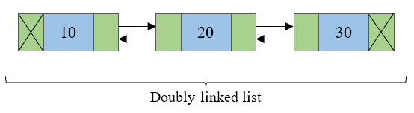
Double Linked List
Doubly linked list is a collection of nodes linked together in a sequential way.
Doubly linked list is almost similar to singly linked list except it contains two address or reference fields, where one of the address field contains reference of the next node and other contains reference of the previous node.
First and last node of a linked list contains a terminator generally a nullptr value, that determines the start and end of the list.
Doubly linked list is sometimes also referred as bi-directional linked list since it allows traversal of nodes in both direction.
Since doubly linked list allows the traversal of nodes in both direction, we can keep track of both first and last nodes.

Slide 20
Double versus Single Linked List
Advantages over singly linked list
A DLL can be traversed in both forward and backward direction.
The delete operation in DLL is more efficient if pointer to the node to be deleted is given.
Disadvantages over singly linked list
Every node of DLL Require extra space for an previous pointer.
All operations require an extra pointer previous to be maintained.

Slide 21
Types of Lists: Circular Linked List
  Circular linked list
    The pointer from the last element in the list points back to the first element.
head
A
B
C

Slide 22
Circular Linked List
A circular linked list is basically a linear linked list that may be single- or double-linked.
The only difference is that there is no any nullptr value terminating the list.
In fact in the list every node points to the next node and last node points to the first node, thus forming a circle. Since it forms a circle with no end to stop it is called as circular linked list.
In circular linked list there can be no starting or ending node, whole node can be traversed from any node.
In order to traverse the circular linked list, only once we need to traverse entire list until the starting node is not traversed again.
A circular linked list can be implemented using both singly linked list and doubly linked list.

Slide 23
Operations on Linked Lists

Slide 24
Operations on single linked list
Traversing a list
  Printing, finding minimum, etc.
Insertion of a node into a list
  At front, end and anywhere, etc.
Deletion of a node from a list
  At front, end and anywhere, etc.
Comparing two linked lists
  Similarity, intersection, etc.
Merging two linked lists into a larger list
  Union, concatenation, etc.
Ordering a list
  Reversing, sorting, etc.

Slide 25
Traversing a Linked List

Slide 26
Single Linked List: Traversing
Once the linked list has been constructed and header points to the first node of the list,
  Follow the pointers.
  Display the contents of the nodes as they are traversed.
  Stop when the next pointer points to nullptr.

Slide 27
Single linked list: Traversing
void traverseList()
{
Node *walk;
walk = header;
while(walk != nullptr){
cout<<, temp->data); //Prints the data of current node
walk = walk >next; //Advances the position of current node
}
}
}

Slide 28
Insertion in a Linked List

Slide 29
Single Linked List: Insertion
Insertion steps:
  Create a new node
  Start from the header node
  Manage links to
    Insert at front
    Insert at end
    Insert at any position

Slide 30
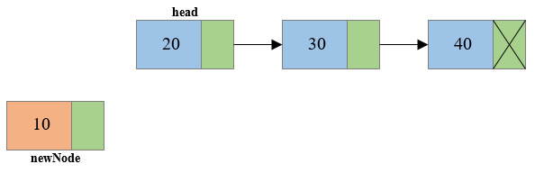
Insertion at Front
Steps to insert node at the beginning of singly linked list
Step 1: Create a new node.

Slide 31
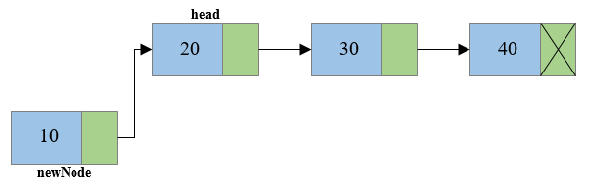
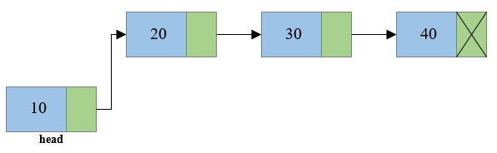
Insertion at Front
Step 2: Link the newly created node with the head node, i.e. the newNode will now point to head node.
Step 3: Make the new node as the head node, i.e. now head node will point to newNode.

Slide 32
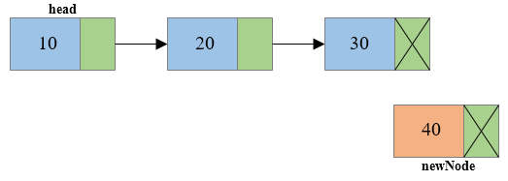
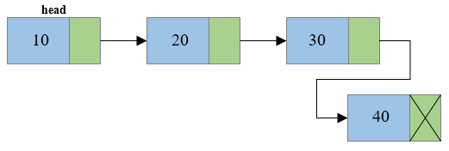
Single Linked List: Insertion at End
Steps to insert node at the end of Singly linked list
Step 1: Create a new node and make sure that the address part of the new node points to nullptr. i.e. newNode->next=nullptr
Step 2: Traverse to the last node of the linked list and connect the last node of the list with the new node, i.e. last node will now point to new node. (lastNode->next = newNode).

Slide 33
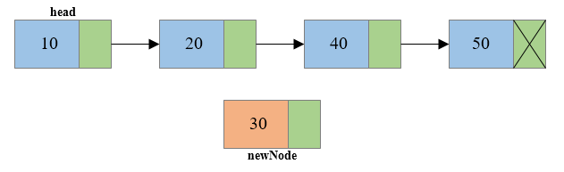
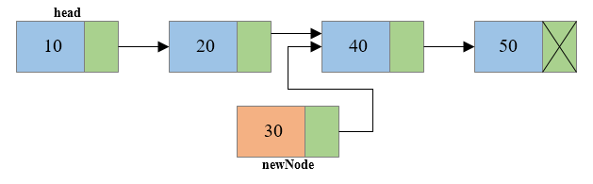
Single Linked List: Insertion at any Position
Steps to insert node at any position of Singly Linked List
Step 1: Create a new node.
Step 2: Traverse to the n-1th position of the linked list and connect the new node with the n+1th node. (newNode->next = temp->next) where temp is the n-1th node.

Slide 34
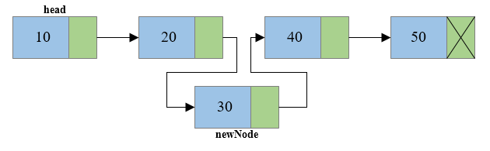
Single Linked List: Insertion at any position
Step 3: Now at last connect the n-1th node with the new node i.e. the n-1th node will now point to new node. (temp->next = newNode) where temp is the n-1th node.

Slide 35
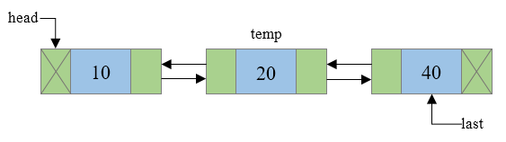
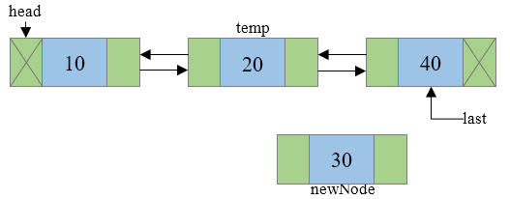
Double Linked List: Insertion at any Position
Steps to insert a new node at n^{th} position in a Doubly linked list.
Step 1: Traverse to N-1 node in the list, where N is the position to insert. Say temp now points to N-1th node.
Step 2: Create a newNode that is to be inserted and assign some data to its data field.

Slide 36
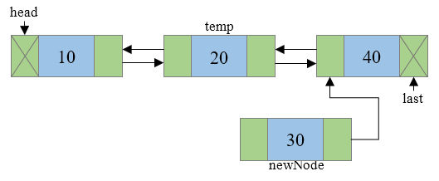
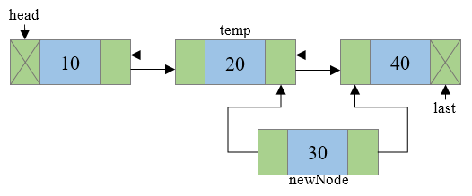
Doubly Linked List: Insertion at any Position
Step 3: Connect the next address field of newNode with the node pointed by next address field of temp node.
Step 4: Connect the previous address field of newNode with the temp node.

Slide 37
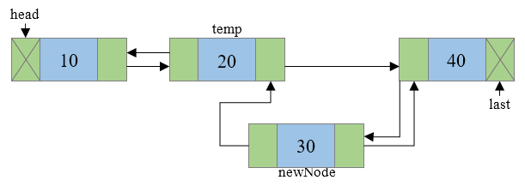
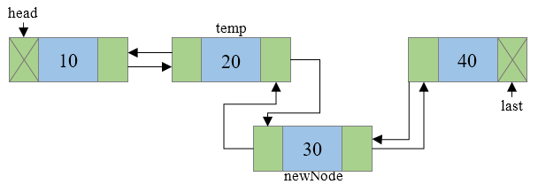
Doubly Linked List: Insertion at any Position
Step 5: Check if temp.next is not nullptr then, connect the previous address field of node pointed by temp.next to newNode.
Step 6: Connect the next address field of temp node to newNode.

Slide 38
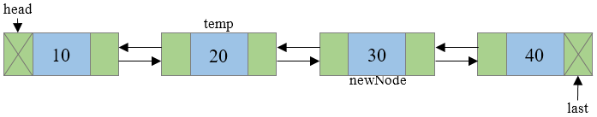
Doubly Linked List: Insertion at any Position
Step 7: Final doubly linked list looks like

Slide 39
Few Exercises to Try Out
For doubly linked list write a function to:
Insert a node at front of the list and at end of the list.
    insert_front(data);
    insert_end(data);
Sort the DLL in ascending order.
Count the number of nodes in the given DLL.

Slide 40
Deletion from a Linked List

Slide 41
Single Linked List: Deletion
Deletion steps
  Start from the header node
  Manage links to
    Delete at front
    Delete at end
    Delete at any position
  freeingup the node as free space.

Slide 42
Free Memory after Deletion
Do not forget to free()/delete memory location dynamically allocated for a node after deletion of that node.
It is the programmer’s responsibility to free that memory block.
Failure to do so may create a dangling pointer – a memory, that is not used either by the programmer or by the system.
The content of a free memory is not erased until it is overwritten.

Slide 43
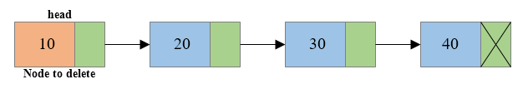
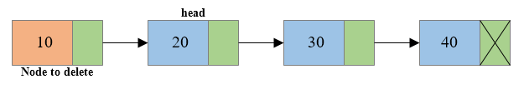
Single Linked List: Deletion at Front
Steps to delete first node of Singly Linked List
Step 1: Copy the address of first node i.e. head node to some temp variable say toDelete.
Step 2: Move the head to the second node of the linked list (head = head->next).

Slide 44
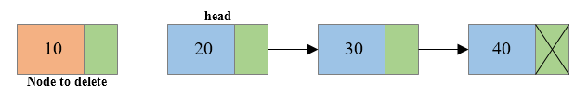

Single linked list: Deletion at front
Step 3: Disconnect the connection of first node to second node.
Step 4: Free the memory occupied by the first node.

Slide 45
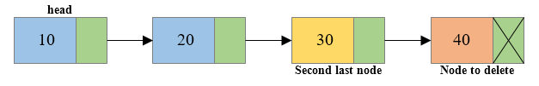
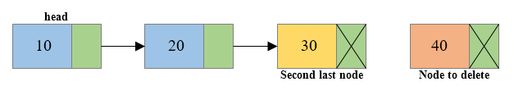
Single linked list: Deletion at End
Steps to delete last node of a Singly Linked List
Step 1: Traverse to the last node of the linked list keeping track of the second last node in some temp variable say secondLastNode.
Step 2: If the last node is the head node then make the head node as nullptr else disconnect the second last node with the last node i.e. secondLastNode->next = nullptr

Slide 46
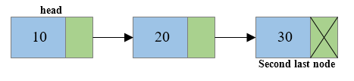
Single linked list: Deletion at End
Step 3: Free the memory occupied by the last node.

Slide 47
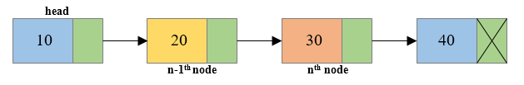
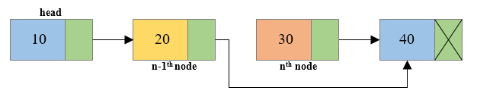
Single Linked List: Deletion at any Position
Steps to delete a node at any position of Singly Linked List
Step 1: Traverse to the n^{th} node of the singly linked list and also keep reference of n-1th node in some temp variable say prevNode.
Step 2: Reconnect n-1th node with the n+1th node i.e. prevNode->next = toDelete->next (Where prevNode is n-1th node and toDelete node is the n^{th} node and toDelete->next is the n+1th node).

Slide 48
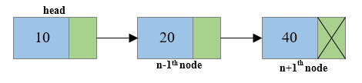
Single Linked List: Deletion at any Position
Step 3: Free the memory occupied by the n^{th} node i.e. toDelete node.

Slide 49
Comparing Two Linked Lists

Slide 50
Single Linked List: Comparing two Lists
Comparing two linked list includes
Identifying whether the given two linked list are identical.
Two Linked Lists are identical when they have same data and arrangement of data is also same.
Checking whether the lists have same values when the arrangement is not same.

Slide 51
Few Exercises to Try Out
Write a function to:
Concatenate or merge two given list into one big list.
Compare two given list with same data but different arrangement.
e.g: a: 5->4->3->2->1
b: 1->2->3->4->5
Count the number of nodes in the given list using iterative method and recursive method.

Slide 52
Ordering Linked List

Slide 53
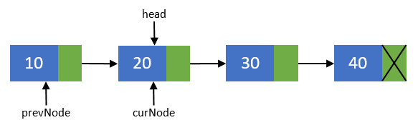
Single Linked List: Reversing
Reversing a list can be performed in two ways:
Iterative method
Recursive method
Steps to reverse a Singly Linked List using Iterative method
Step 1: Create two more pointers other than head namely prevNode and curNode that will hold the reference of previous node and current node respectively.
Make sure that prevNode points to first node i.e. prevNode = head.
head should now point to its next node i.e. head = head->next.
curNode should also points to the second node i.e. curNode = head.

Slide 54
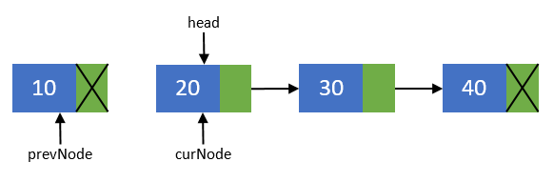
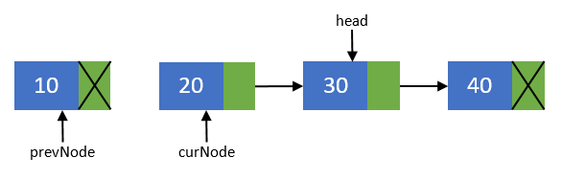
Reversing a List
Step 2: Now, disconnect the first node from others. We will make sure that it points to none. As this node is going to be our last node. Perform operation prevNode->next = nullptr.
Step 3: Move the head node to its next node i.e. head = head->next.

Slide 55
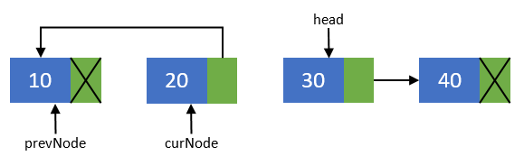
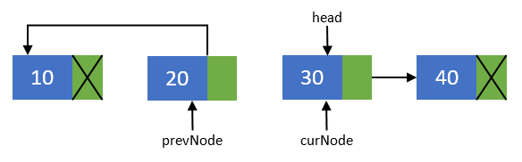
Reversing a List
Step 4: Now, re-connect the current node to its previous node
i.e. curNode->next = prevNode;
Step 5: Point the previous node to current node and current node to head node. Means they should now point to prevNode = curNode; and curNode = head.

Slide 56
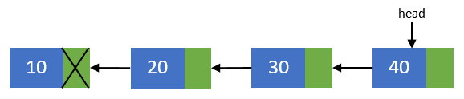
Reversing a List
Step 6: Repeat steps 3-5 till head pointer becomes nullptr.
Step 7: Now, after all nodes has been re-connected in the reverse order. Make the last node as the first node. Means the head pointer should point to prevNode pointer.
Perform head = prevNode; And finally you end up with a reversed linked list of its original.

Slide 57
Single Linked List: Sorting
The linked list can be ordered using any of the following sorting algorithms:
Insertion sort
Selection sort
Merge sort ??
Quick sort??
Bubble sort, etc.
Here, we discuss insertion sort for ordering linked list.

Slide 58

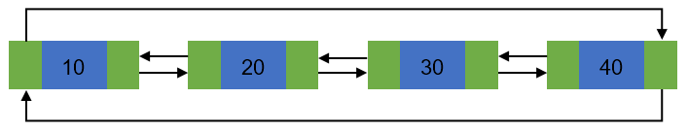
Circular linked list:
Basic structure of singly circular linked list:
Doubly circular linked list:

Slide 59
Circular linked list:
Advantages of a Circular linked list
Entire list can be traversed from any node.
Circular lists are the required data structure when we want a list to be accessed in a circle or loop.
Despite of being singly circular linked list we can easily traverse to its previous node, which is not possible in singly linked list.
Disadvantages of Circular linked list
Circular list are complex as compared to singly linked lists.
Reversing of circular list is a complex as compared to singly or doubly lists.
If not traversed carefully, then we could end up in an infinite loop.
Like singly and doubly lists circular linked lists also doesn’t supports direct accessing of elements.

Slide 60
Operations on circular linked list
Creation of list
Traversal of list
Insertion of node
    At the beginning of list
    At any position in the list
Deletion of node
    Deletion of first node
    Deletion of node from middle of the list
    Deletion of last node
Counting total number of nodes
Reversing of list

Slide 61
Circular Linked List: Creation of List
Code to be inserted during lecture hour and slides will be uploaded

Slide 62
Circular Linked List: Traversal of List
void displayList()
{
}

Slide 63
Try Out
For circular linked list write a function to:
Insert a node at any position of the list and delete from the beginning of the list.
    insert_position(data,position);
    delete_front();
Reverse the given circular linked link.

