Slide 1
Recursion CENG 218 Data Structures
Based on [Carrano and Henry]

Slide 2
Overview
Get a basic understanding of recursion, one of the most powerful techniques in computer science.
Examine the thought process leading to recursive solutions.
Learn techniques that help understanding the mechanics of recursion.

Slide 3
The Basic Idea
Recursion is an extremely powerful problem-solving technique.
Recursion tries to
break a problem into smaller identical problems.
solve the problem by solving smaller instances of the same problem.
(The solutions of the smaller problems will lead to the solution of the original problem.)
Problems that at first appear to be quite difficult often have simple recursive solutions.

Slide 4
About Efficiency
The technique of recursion, though powerful, does not guarantee you an efficient solution.
Some recursive solutions are so inefficient that they should not be used.
Overhead associated with function calls.
Inherent inefficiency of some recursive algorithms.
We will come back to the efficiency issue later.

Slide 5
An Example (1/2)
Looking up a word in a dictionary using binary search:
if (the dictionary contains only one page)
Scan the page for the word
else {
Open the dictionary to a point near the middle
Determine which half contains the word
if (the word is in the first half)
Search the first half for the word
else
Search the second half for the word
}

Slide 6
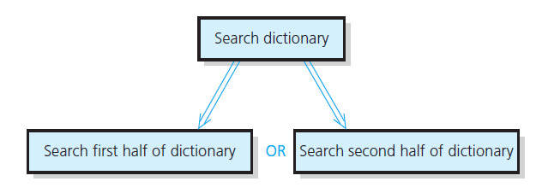
An Example (2/2)
The binary search strategy reduces the search problem to a smaller instance of the same problem:
Source: FIGURE 2-1 in [Carrano and Henry 2013].

Slide 7
Deriving a Recursive Solution (1/2)
Binary search reduces the problem of searching the dictionary for a word to a problem of searching half of the dictionary for the word.
Two important points:
Once you have divided the dictionary in halves, you already know how to search the appropriate half.
There is a special case that is different from all the other cases: dictionary with a single page.
Stop dividing and solve the problem directly.
This special case is called the base case (or basis).

Slide 8
Deriving a Recursive Solution (2/2)
Binary search falls into the general strategy of divide and conquer.
You solve the dictionary search problem by first dividing the dictionary into two halves.
And then conquering the appropriate half (a smaller problem).
You solve the smaller problem by using the same divide-and-conquer strategy until you reach the base case.
Many recursive solutions utilize the divide-and-conquer strategy.

Slide 9
The Search Example Revisited
More rigorous pseudocode:
search(aDcitionary: Dictionary, word: string)
if (aDictionary is one page in size)
Scan the page for word
else {
Open aDictionary to a point near the middle
Determine which half contains word
if (word is in the first half of aDictionary)
search(first half of aDictionary, word)
else
search(second half of aDictionary, word)
}

Slide 10
Observations from a Recursive Solution
A recursive function calls itself.
E.g., the search function calls search(first/second half of aDictionary, word).
Each recursive call solves an identical, but smaller, problem.
The solution to at least one smaller problem— the base case—is known.
When you reach the base case, the recursive calls stop and you solve the problem directly.
E.g., the function search scan the page for the word when the dictionary contains only one page.
The diminishing size of the problem ensures that you will eventually reach the base case.

Slide 11
Binary Search Algorithm
Searching a list for a particular value
sequential and binary are two common algorithms
Sequential search (aka linear search):
Not very efficient
Easy to understand and program
Binary search:
more efficient than sequential
but the list must be sorted first!

Slide 12
Why Is It Called "Binary" Search?
Compare sequential and binary search algorithms: How many elements are eliminated from the list each time a value is read from the list and it is not the "target" value?
Sequential search: only one item
Binary search: half the list!
That is why it is called binary -
each unsuccessful test for the target value
reduces the remaining search list by 1/2.

Slide 13
Binary Search Method
find(target) calls private search(array, target, first, last)
returns the index of the entry if the target value is found or -1 if it is not found
Compare it to the pseudocode for the "name in the phone book" problem

Slide 14
Where is the composition?
If no items
not found (-1)
Else if target is in the middle
middle location
Else
location found by search(first half) or search(second half)

Slide 15
Binary Search Example
target is 33
The array a looks like this:
Indices
Contents
0 1 2 3 4 5 6 7 8 9
5 7 9 13 32 33 42 54 56 88
mid = (0 + 9) / 2 (which is 4)
33 > a[mid] (that is, 33 > a[4])
So, if 33 is in the array, then 33 is one of:
5 6 7 8 9
33 42 54 56 88
Eliminated half of the remaining elements from consideration because array elements are sorted.

Slide 16
Binary Search Example
target is 33
The array a looks like this:
Indexes
Contents
0 1 2 3 4 5 6 7 8 9
5 7 9 13 32 33 42 54 56 88
mid = (5 + 9) / 2 (which is 7)
33 < a[mid] (that is, 33 < a[7])
So, if 33 is in the array, then 33 is one of:
Eliminate half of the remaining elements
5 6
33 42
mid = (5 + 6) / 2 (which is 5)
33 == a[mid]
So we found 33 at index 5:
5
33

Slide 17
Four Questions to Ask/Answer
How can you define the problem in terms of smaller problems of the same type?
How does each recursive call diminish the size of the problem?
What instance(s) of the problem can serve as the base case?
As the problem size diminishes, will you reach this base case?

Slide 18
A Recursive Function: Factorial (1/4)
An iterative definition of factorial(n):
factorial(n) = n * (n – 1) * (n – 2) * … * 1
for any integer n > 0
factorial(0) = 1
(Note: the factorial of a negative integer is undefined.)
A recursive definition of factorial(n)
factorial(n) = n * factorial(n–1) if n > 0
= 1 if n = 0
(Note: the base case is deliberately given later.)

Slide 19
A Recursive Function: Factorial (2/4)
It is easy to construct a C++ function that implements the definition.
/** Computes the factorial of the nonnegative integer n.
@pre n must be greater than or equal to 0.
@post None.
@return The factorial of n; n is unchanged. */
int fact(int n)
{
if (n == 0)
return 1;
else // n > 0
return n * fact(n-1);
} // end fact
base case

Slide 20
A Recursive Function: Factorial (3/4)
Does function fact fit the mold of a recursive solution?
One action of fact is to call itself.
Each recursive call to fact diminishes the size of the problem by 1.
fact(0) is the base case.
Given that n is nonnegative, you always reach the base case.
Note that fact assumes the input n is non-negative, as stated in its precondition.

Slide 21
A Recursive Function: Factorial (4/4)
cout << fact(3);
6
return 3*fact(2);
3*2
fact(n-1) is evaluated
return 2*fact(1);
2*1
int fact(int n)
{
if (n == 0)
return 1;
else // n > 0
return n * fact(n-1);
} // end fact
return 1*fact(0);
1*1
base case
return 1;

Slide 22
Box Traces
A box trace is an illustration of how a compiler usually implements recursion.
You may use it to help you understand recursion and to debug a recursive function.
Each box in a box trace roughly corresponds to an “activation record.”

Slide 23
Constructing a Box Trace (1/7)
Label each recursive call in the body of the recursive function.
These labels help you keep track of the correct place to which you must return after a function call completes.
int fact(int n)
{ if (n == 0)
return 1;
else
return n * fact(n-1);
}
(A)

Slide 24
Constructing a Box Trace (2/7)
During the course of an execution, represent each call to the function by a new box, containing:
A copy of the actual value arguments.
A placeholder for the value returned by each recursive call from the current box.
Label this placeholder to correspond to the label in Step 1.
The value of the function itself.
The function’s local variables.
cout << fact(3);
n = 3;
A: factor(n-1) = ?
return ?
when you first create a box, you will know only the values of the
input arguments. You fill in the values of the other items as you
determine them from the function’s execution.

Slide 25
Constructing a Box Trace (3/7)
When you create a new box after a recursive call, draw an arrow from the box that makes the call to the newly created box.
Label each arrow to correspond to the label of the recursive call.
After you create the new box and arrow, start executing the body of the function.
n = 3
A: fact(n-1) = ?
return ?
n = 2
A: fact(n-1) = ?
return ?
cout << fact(3);
A

Slide 26
Constructing a Box Trace (4/7)
On existing the function, cross off the current box and follow its arrow back to the box that called the function.
Substitute the value returned by the just-terminated function call into the appropriate item in the current box.
…
n = 1
A: fact(n-1) = ?
return ?
n = 0 (current)
return 1
A
…
n = 1 (current)
A: fact(n-1) = ?
return?
n = 0 (cross off)
return 1
1

Slide 27
Constructing a Box Trace (5/7)
When you return to point A and substitute the computed value for fact(n-1):
Continue execution by evaluating the expression return n * fact(n-1).
…
n = 1 (current)
A: fact(n-1) = 1
return?
n = 0 (cross off)
return 1
if (n == 0)
return 1;
else
return n * fact(n-1);
(A)

Slide 28
Constructing a Box Trace (6/7)
Box trace of fact(2):
int fact(int n)
{ if (n == 0)
return 1;
else
return n * fact(n-1);
}
The initial call is made, and fact begins execution:
n = 2
A: fact(n-1)=?
return ?
(A)
At point A a recursive call is made, and the new invocation of fact begins execution:
n = 2
A: fact(n-1)=?
return ?
A
n = 1
A: fact(n-1)=?
return ?
At point A a recursive call is made, and the new invocation of fact begins execution:
n = 2
A: fact(n-1)=?
return ?
A
n = 1
A: fact(n-1)=?
return ?
A
n = 0
return ?
This is the base case, so this invocation of fact completes:
n = 2
A: fact(n-1)=?
return ?
A
n = 1
A: fact(n-1)=?
return ?
A
n = 0
return 1

Slide 29
Constructing a Box Trace (7/7)
The method value is returned to the calling box, which continues execution:
n = 2
A: fact(n-1)=?
return ?
A
n = 1
A: fact(n-1)=1
return ?
n = 0
return 1
int fact(int n)
{ if (n == 0)
return 1;
else
return n * fact(n-1);
}
The current invocation of fact completes:
n = 2
A: fact(n-1)=?
return ?
A
n = 1
A: fact(n-1)=1
return 1
n = 0
return 1
(A)
The method value is returned to the calling box, which continues execution:
n = 2
A: fact(n-1)=1
return ?
n = 1
A: fact(n-1)=1
return 1
n = 0
return 1
The current invocation of fact completes:
n = 2
A: fact(n-1)=1
return 2
n = 1
A: fact(n-1)=1
return 1
n = 0
return 1
The value 2 is returned to the initial call.

Slide 30
Invariants for Recursive Functions
Writing invariants for recursive functions is as important as writing them for iterative functions.
An invariant is a condition that is always true at a particular point in an algorithm/program.
/**
@pre n must be greater than or equal to 0.
@return the factorial of n. */
int fact(int n)
{
if (n == 0)
return 1;
else
// Invariant: n > 0, so n-1 >= 0.
// Thus, fact(n-1) returns (n-1)!
return n * fact(n-1);
} // end fact
The recursive call satisfies
fact’s precondition, so you
can expect from the post-
condition that fact(n-1) will
return the factorial of n-1.

Slide 31
Return a Value Recursion Example: Powers
Recall predefined function pow(): result = pow(2.0,3.0);
Returns 2 raised to power 3 (8.0)
Takes two double arguments
Returns double value
Let’s write recursively
For simple example

Slide 32
Function Definition for power()
int power(int x, int n) { if (n<0) { cout << "Illegal argument"; exit(1); } if (n>0) return (power(x, n-1)*x); else return (1); }

Slide 33
Calling Function power()
Example calls:
power(2, 0); → returns 1
power(2, 1); → returns (power(2, 0) * 2); → returns 1
Value 1 multiplied by 2 & returned to original call

Slide 34
Calling Function power()
Larger example: power(2,3); → power(2,2)*2 → power(2,1)*2 →power(2,0)*2 →1
Reaches base case
Recursion stops
Values "returned back" up stack

Slide 35
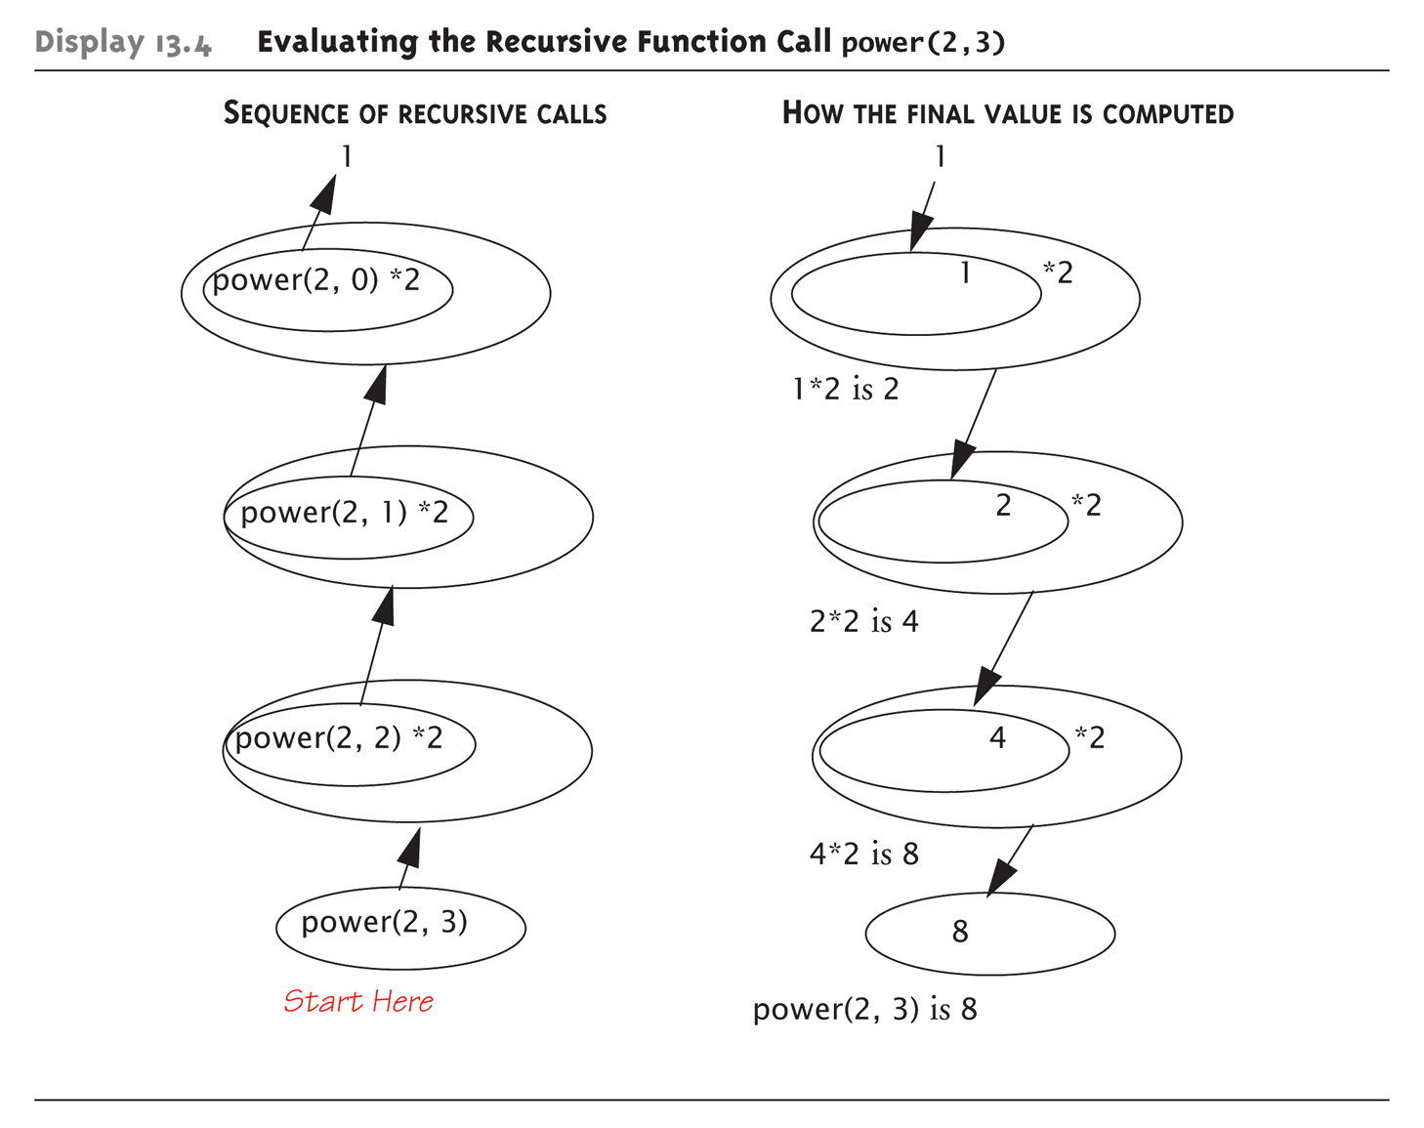
Tracing Function power(): Evaluating the Recursive Function Call power(2,3)

Slide 36
Recursive void Function: Vertical Numbers
Task: display digits of number vertically, one per line
Example call: writeVertical(1234); Produces output: 1 2 3 4

Slide 37
Vertical Numbers: Recursive Definition
Break problem into two cases
Simple/base case: if n<10
Simply write number n to screen
Recursive case: if n>=10, two subtasks:
1- Output all digits except last digit
2- Output last digit
Example: argument 1234:
1st subtask displays 1, 2, 3 vertically
2nd subtask displays 4

Slide 38
writeVertical Function Definition
Given previous cases: void writeVertical(int n) { if (n < 10) //Base case cout << n << endl; else { //Recursive step writeVertical(n/10); cout << (n%10) << endl; } }

Slide 39
writeVertical Trace
Example call: writeVertical(123); → writeVertical(12); (123/10) → writeVertical(1); (12/10) → cout << 1 << endl; cout << 2 << endl; cout << 3 << endl;
Arrows indicate task function performs
Notice 1st two calls call again (recursive)
Last call (1) displays and "ends"

Slide 40
A Recursive Procedure: writeBackward (1/5)
Problem:
Given a string of characters, write it in reverse order.
E.g., “cat” → “tac”, “im” → “mi”
To construct a recursive solution, you should ask/answer the four questions.
Note that a procedure is implemented as a “void function” in C++ (and several other languages).

Slide 41
A Recursive Procedure: writeBackward (2/5)
Question 1: how can you define the problem in terms of smaller problems of the same type?
Find a solution to the problem of writing a string of length n backward in terms of the solution to the problem of writing a string of length n–1 backward.
Which string of length n–1?
The ability to write a substring of length n–1 backward, combined with the ability to perform some minor task, must result in the ability to write the original string backward.
Which character to strip away?

Slide 42
A Recursive Procedure: writeBackward (3/5)
Question 2: how does each recursive call diminish the size of the problem?
The length of the string goes from n down to n–1.
Question 3: what instance of the problem can serve as the base case?
Write the empty string backward.
Do nothing at all.
Question 4: as the problem size diminishes, will you reach this base case?
Yes.

Slide 43
A Recursive Procedure: writeBackward (4/5)
Consider stripping away the last character:
For the solution to be valid, you must write the last character in the string first.
writeBackward(s: string)
if (the string is empty)
Do nothing – this is the base case
else {
Write the last character of s
writeBackward(s minus its last character)
}
minor task
strip away the last character

Slide 44
A Recursive Procedure: writeBackward (5/5)
The C++ function writeBackward:
/** Writes a character string backward.
@pre The string s to write backward.
@post None.
@param s The string to write backward. */
void writeBackward(string s)
{
int length = s.size(); // Length of s
if (length > 0) {
// Write the last character
cout << s.substr(length - 1, 1);
// Write the rest of the string backward
writeBackward(s.substr(0, length – 1)); // Point A
} // end if
// length == 0 is the base case - do nothing
} // end writeBackward

Slide 45
A Box Trace of writeBackward (1/3)
Box trace of writeBackward(“im”):
Each box contains the local environment of the recursive call:
The input argument s.
The local variable length.
No placeholder for the value returned by each recursive call or the value of the function itself.
Because the void function writeBackward does not use a return statement to return a computed value.

Slide 46
A Box Trace of writeBackward (2/3)
The initial call is made, and the function begins execution:
s = “im”
length = 2
Output line: m
Point A (writeBackward(s.substr(0, length-1)) is reached, and
the recursive call is made.
The new invocation begins execution:
s = “im”
length = 2
A
s = “i”
length = 1
Output line: mi
Point A is reached, and the recursive call is made.
The new invocation begins execution:
s = “im”
length = 2
A
s = “i”
length = 1
A
s = “”
length = 0

Slide 47
A Box Trace of writeBackward (3/3)
This (length==0) is the base case, so this invocation completes.
Control returns to the calling box, which continues execution:
s = “im”
length = 2
A
s = “i”
length = 1
s = “”
length = 0
This invocation completes.
Control returns to the calling box, which continues execution:
s = “im”
length = 2
s = “i”
length = 1
s = “”
length = 0
This invocation completes.
Control returns to the statement following the initial call.

Slide 48
An Alternative writeBackward (1/2)
How is the second alternative?
Strip away the first character:
writeBackward2(s: string)
if (the string s is empty)
Do nothing – this is the base case
else {
writeBackward2(s minus its first character)
Write the first character of s
}

Slide 49
An Alternative writeBackward (2/2)
When debugging (or tracing) a recursive function, try to use cout statements at the beginning, interior, and end of the function to report the values of local variables.
writeBackward2(s: string)
cout << “Enter writeBackward2 with string: “ << s << endl;
if (the string is empty)
Do nothing – this is the base case
else {
writeBackward2(s minus its first character) // Point A
cout << “About to write first character of string:” << s << endl;
Write the first character of s
}
cout << “Leave writeBackward2 with string: “ << s << endl;

Slide 50
A Box Trace of writeBackward2
Box trace of writeBackward2(“im”):
s=“im”
Enter writeBackward2 with string: im
Enter writeBackward2 with string: m
Enter writeBackward2 with string:
Leave writeBackward2 with string:
About to write first character of string: m
m
Leave writeBackward2 with string: m
About to write first character of string: im
i
Leave writeBackward2 with string: im
A
s=“im”
s=“m”
A
A
s=“im”
s=“m”
s=“”
A
s=“im”
s=“m”
s=“”
s=“im”
s=“m”
s=“”

Slide 51
Searching an Array: Binary Search (1/8)
A high-level binary search:
Search a sorted array of integers for a given value.
anArray[0] <= anArray[1] <= … <= anArray[size-1]
binarySearch(anArray: ArrayType, target: ValueType)
if (anArray is of size 1)
Determine if anArray’s value is equal to target
else {
Find the midpoint of anArray
Determine which half of anArray contains target
if (target is in the first half of anArray)
binarySearch(first half of anArray, target)
else
binarySearch(second half of anArray, target)
}

Slide 52
Searching an Array: Binary Search (2/8)
How will you pass “half of anArray” to the recursive calls to binarySearch?
binarySearch(anArray, first, last, target)
Pass the entire array at each call, but have binarySearch search only anArray[first..last].
The midpoint in [first..last] is:
mid = (first + last) / 2
Then binarySearch(first half of anArray, value):
binarySearch(anArray, first, mid-1, target)
binarySearch(second half of anArray, target):
binarySearch(anArray, mid+1, last, target)

Slide 53
Searching an Array: Binary Search (3/8)
How do you determine which half of the array contains target?
The first half will be: if (target < anArray[mid]).
Remember to test the equality between target and anArray[mid].
What should the base case(s) be?
target == anArray[mid]
When target is in the array.
first > last
When target is not in the array.

Slide 54
Searching an Array: Binary Search (4/8)
How will binarySearch indicate the result of the search?
A negative value if it does not find target in the array.
The index of the array item that is equal to target.

Slide 55
Searching an Array: Binary Search (5/8)
int binarySearch(const int anArray[], int first, int last, int target)
{
int index;
if (first > last)
index = -1; // target not in original array
else {
int mid = first + (last - first)/2;
if (target == anArray[mid])
index = mid; // value found at anArray[mid]
Base cases.

Slide 56
Searching an Array: Binary Search (6/8)
Determine which half by comparison.
else if (target < anArray[mid])
// Point X
index = binarySearch(anArray, first, mid-1,
target);
else
// Point Y
index = binarySearch(anArray, mid+1, last,
target);
} // end if
return index;
} // end binarySearch
Specify the range of the half array.

Slide 57
Searching an Array: Binary Search (7/8)
Box trace of binarySearch:
anArray = <1, 5, 9, 12, 15, 21, 29, 31>
Search for 9.
target = 9
first = 0
last = 7
mid = (0+7)/2 = 3
target < anArray[3]
X: binarySearch =
return
target = 9
first = 0
last = 2
mid = (0+2)/2 = 1
target > anArray[1]
Y: binarySearch =
return
target = 9
first = 2
last = 2
mid = (2+2)/2 = 2
target = anArray[2]
return 2
X
Y
2
2
2
2

Slide 58
Searching an Array: Binary Search (8/8)
Box trace of binarySearch:
anArray = <1, 5, 9, 12, 15, 21, 29, 31>
Search for 6.
target = 6
first = 0
last = 7
mid = (0+7)/2 = 3
target < anArray[3]
X: binarySearch =
return
target = 6
first = 0
last = 2
mid = (0+2)/2 = 1
target > anArray[1]
Y: binarySearch =
return
target = 6
first = 2
last = 2
mid = (2+2)/2 = 2
target < anArray[2]
X: binarySearch =
return
target = 6
first = 2
last = 1
first > last
return -1
X
Y
X
-1
-1
-1
-1
-1
-1

Slide 59
Searching an Array: Another Binary Search
int binarySearch2(const int anArray[], int first, int last,
int target)
{ int index;
if (first == last)
if (target == anArray[first])
index = first; // target found at anArray[first]
else
index = -1; // target not in original array
else {
int mid = first + (last - first)/2;
if (target < anArray[mid])
index = binarySearch2(anArray, first, mid-1, target);
else
index = binarySearch2(anArray, mid, last, target);
}
return index;
}
Base case

Slide 60
Searching an Array: the Largest Item (1/2)
A recursive solution
if (anArray has only one entry)
maxArray(anArray) is the entry in anArray
else if (anArray has more than one entry) maxArray(anArray) is the maximum of
maxArray(left half of anArray) and
maxArray(right half of anArray)
AND
Source: FIGURE2-12 in [Carrano and Henry 2013]

Slide 61
Searching an Array: the Largest Item (2/2)
maxArray(<1,6,8,3>)
return max( maxArray(<1,6>), maxArray(<8,3>) )
= 8
6
8
maxArray(<1,6>)
return max( maxArray(<1>), maxArray(<6>) )
maxArray(<8,3>)
return max( maxArray(<8>), maxArray(<3>) )
1
6
8
3
maxArray(<1>)
return 1
maxArray(<6>)
return 6
maxArray(<8>)
return 8
maxArray(<3>)
return 3

Slide 62
Recursion and Efficiency
Recursion is a powerful problem-solving technique that often produces very clear solutions to complex problems.
Some recursive solutions are so inefficient that they should not be used.
binarySearch and solveTowers are exceptions; they are quite efficient.
Factors that contribute to the inefficiency of some recursive solutions:
Overhead associated with function calls.
Inherent inefficiency of some recursive algorithms.

Slide 63
Recursion and Efficiency
In most programming languages, a function call incurs a bookkeeping overhead.
Local variables, the returning address, … etc.
Recursive functions can generate a lot of recursive calls → magnify this overhead.

Slide 64
Recursion and Efficiency
Do not use a recursive solution if it is inefficient and there is a clear, efficient iterative solution.
You may need to convert a recursive solution to an iterative solution.
void writeBackward(string s)
{ int length = s.size();
if (length > 0) {
cout << s.substr(length-1, 1);
writeBackward(s.substr(0,length-1));
}
}
void writeBackward(string s)
{ int length = s.size();
while (length > 0) {
cout << s.substr(length-1, 1);
length--;
}
}
Tail recursion: the recursive call is the last action
that the function takes.

Slide 65
Summary (1/2)
Recursion solves a problem by solving smaller problems of the same type.
Four questions:
How can you define the problem in terms of smaller problems of the same type?
How does each recursive call diminish the size of the problem?
What instance(s) of the problem can serve as the base case?
As the problem size diminishes, will you reach a base case?

Slide 66
Summary (2/2)
A box trace can be used to trace the actions of a recursive method.
Some recursive solutions are much less efficient than a corresponding iterative solution due to their inherently inefficient algorithms and the overhead of function calls.
If you can easily, clearly, and efficiently solve a problem by using iteration, you should do so.

Slide 67
Remarks
“Recursive thinking” should be better repositioned as “inductive thinking.”
Inductive thinking tries to solve a problem in essentially the same way as recursive thinking.
More importantly, induction is associated with principles of precise mathematical reasoning.
Basically, when you have a positive answer to each of the “four questions” for recursion, you have a proper induction.

Slide 68
Number of Zeros in a Number
Example: 2030 has 2 zeros
If n has two or more digits
the number of zeros is the number of zeros in n with the last digit removed
plus an additional 1 if the last digit is zero
Examples:
number of zeros in 20030 is number of zeros in 2003 plus 1
number of zeros in 20031 is number of zeros in 2003 plus 0
recursive

